Slide 1

A healthy lifestile

Slide 2
HEALTHY HABITS BINGO
Healthy Habits | Name
1. I eat vegetables every day.
2. I drink 8 glasses of water a day.
3. I exercise for at least 30 minutes each day.
4. I get 8 hours of sleep every night.
5. I eat breakfast every morning.
6. I limit screen time to less than 2 hours a day.
7. I choose healthy snacks like nuts, fruit, or yogurt.
8. I take time to relax and de-stress.

Slide 3
https://youtube.com/watch?v=QNeiwTFqx4w&feature=shared
What you eat is important!
The food experiment

Slide 4
HEALTHY EATING CHALLENGE Sort the pictures into healthy and unhealthy categories:
HEALTHY
UNHEALTHY

Slide 5
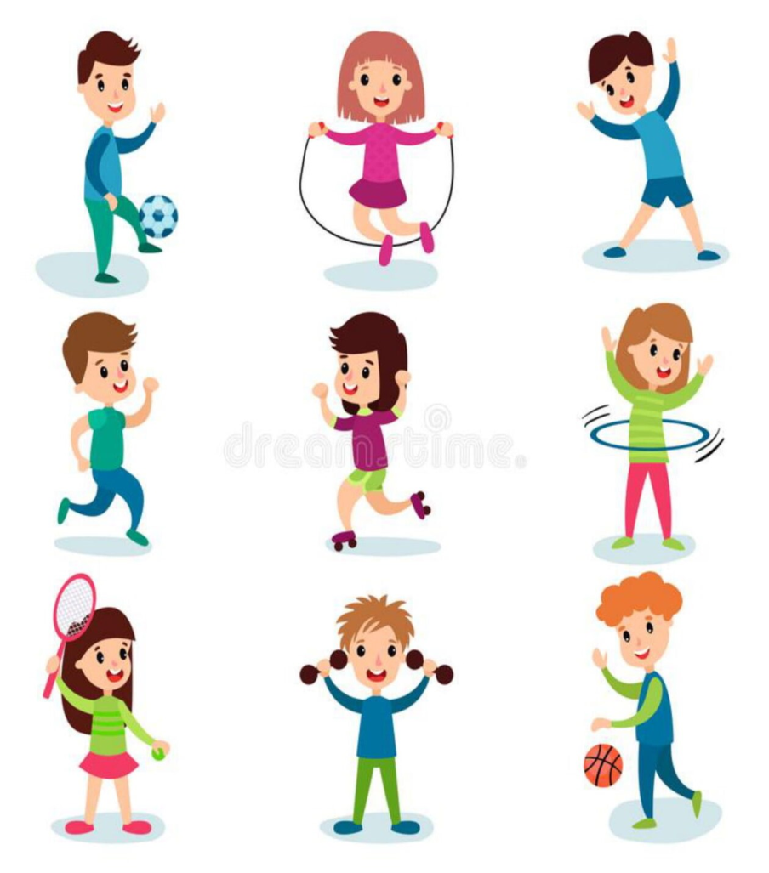

EXERCISE STATION 1. I need a ... voluntary 2. Give examples of simple sports activities that you can practice at home to help maintain your physical condition.

Slide 6

MINDFULNESS PRACTICE
1.Look carefully at the image. 2.Close your eyes. 3. Imagine that you are under that blooming tree. 4. Take a deep breath and think of something nice. 5.How do you feel now?

Slide 7
Write down a new healthy habit you want to try!
Let`s end with a reflection:

Slide 8

Thank you! And don’t forget…Choose a healthy lifestyle!

