Slide 1

Citizenship Education

Slide 2
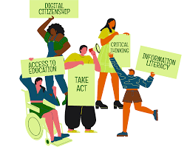
Citizenship education develops knowledge, skills and understanding that pupils need to play a full part in society as active and responsible citizens.

Slide 3
Pupils are taught about democracy, politics, parliament and voting. They also learn about human rights, justice, the law, media and information literacy, climate change and sustainability, personal finance and the economy.

Slide 4
Political literacy is developed alongside the skills of active citizenship through practical opportunities to address issues of concern by taking different forms of responsible, democratic action and campaigning. Throughout the subject teaching is brought to life using real, topical issues and case studies in local to global contexts.

Slide 5
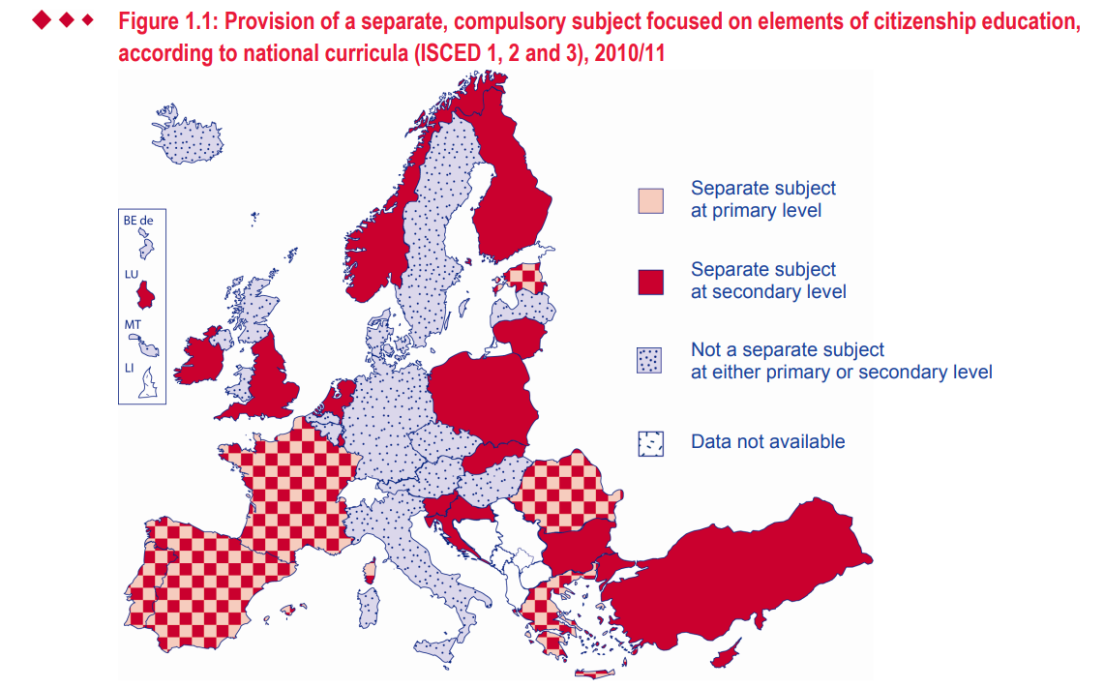
Citizenship Education in Europe

Slide 6
How are we teaching citizenship?
https://www.youtube.com/watch?v=McnG1RNDM9s&t=73s&ab_channel=SDSA

Slide 7
Life skills and citizenship education
https://www.youtube.com/watch?v=ySq_k5FeItE&t=108s&ab_channel=UNICEFmena

Slide 8
Active citizenship
https://www.youtube.com/watch?v=kiZNO_Lca8k&ab_channel=bcactivecitizens

Slide 9
Community participation
https://www.youtube.com/watch?v=8xCrd-tqB48&ab_channel=akankshawakhare

Slide 10
STUDENT COUNCIL
Also known as a student union, associated student body or student parliament is an administrative organization of students in different educational institutes. Student councils often serve to engage students in learning about democracy and leadership.

Slide 11
The student council helps share ideas, interests, and concerns with teachers and institute administrative authorities. It also help raise funds for school-wide activities, including social events, community projects, helping people in need. Many members learn skills that were an extension of their formal education.

Slide 12
What are the benefits of a student council?
There are many benefits of a student council. For example, the student council teaches young people effective leadership skills. It also teaches young people how to give back to the community and help those in need.

Slide 13
What makes a strong student council?
A strong student council is one that includes students who have good grades and are positive role models. Additionally, effective communication and teamwork skills between student council members can make a student council strong. It is just as important to have an adviser who provides council members with guidance.

Slide 14
What is the role of the student council?
The student council has various roles, such as organizing school activities, like prom. The student council is also responsible for handling philanthropic fundraisers, like blood drives or taking donations. Overall, the student council aims to make positive changes that benefit the students, school, and community.

Slide 15
STUDENT COUNCIL
https://www.youtube.com/watch?v=R_h6HSE367c&t=58s&ab_channel=KatherineGrijalva%5BNewtonES%5D

Slide 16
Let’s engage our students!

